Slide 1
Registration

Slide 2
Registration
Registration = aligning different pieces of data to the same coordinate space.

Slide 3
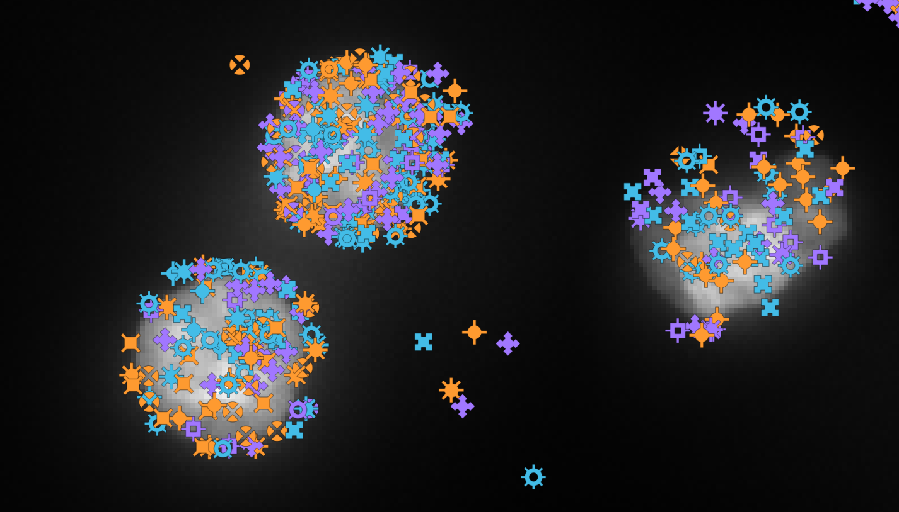
Registration - Targeted transcriptomics
Align transcripts with DAPI image.
Xenium

Slide 4
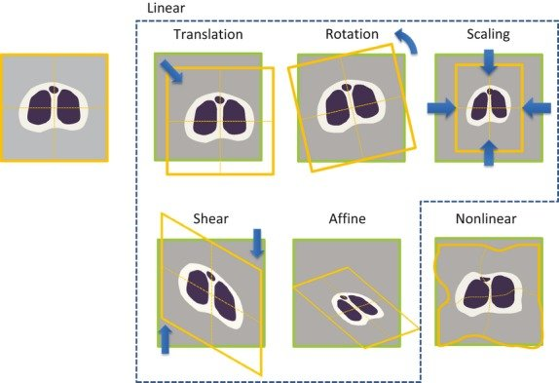
Transformation types
Uchida, Seiichi. (2013). Image processing and recognition for biological images. Development, growth & differentiation. 55. 10.1111/dgd.12054.
Notes:
Affine transformations preserves straight lines and parallelism.

Slide 5

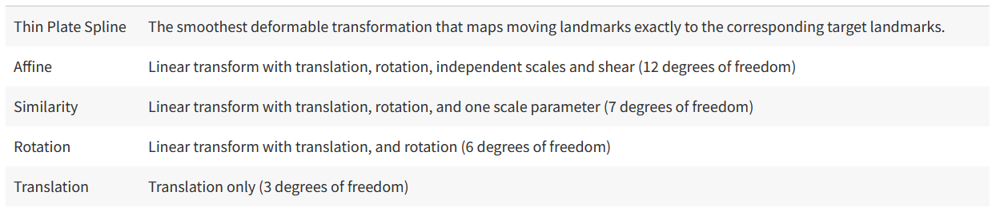
BigWarp
https://imagej.net/plugins/bigwarp
Fixed image and moving image
Can handle large images
Based on manually placed landmarks (i.e. labor-intensive)
Allows affine and nonlinear transformations

Slide 6
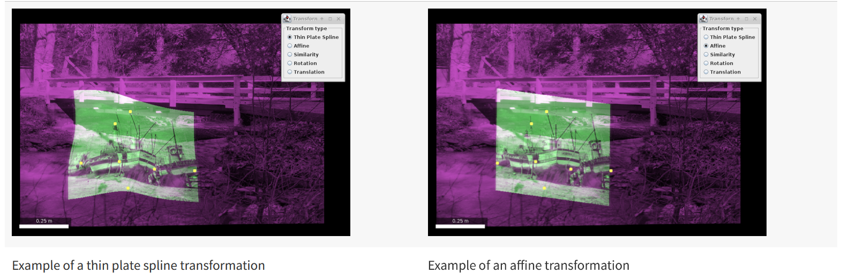
BigWarp – Transformations

Slide 7
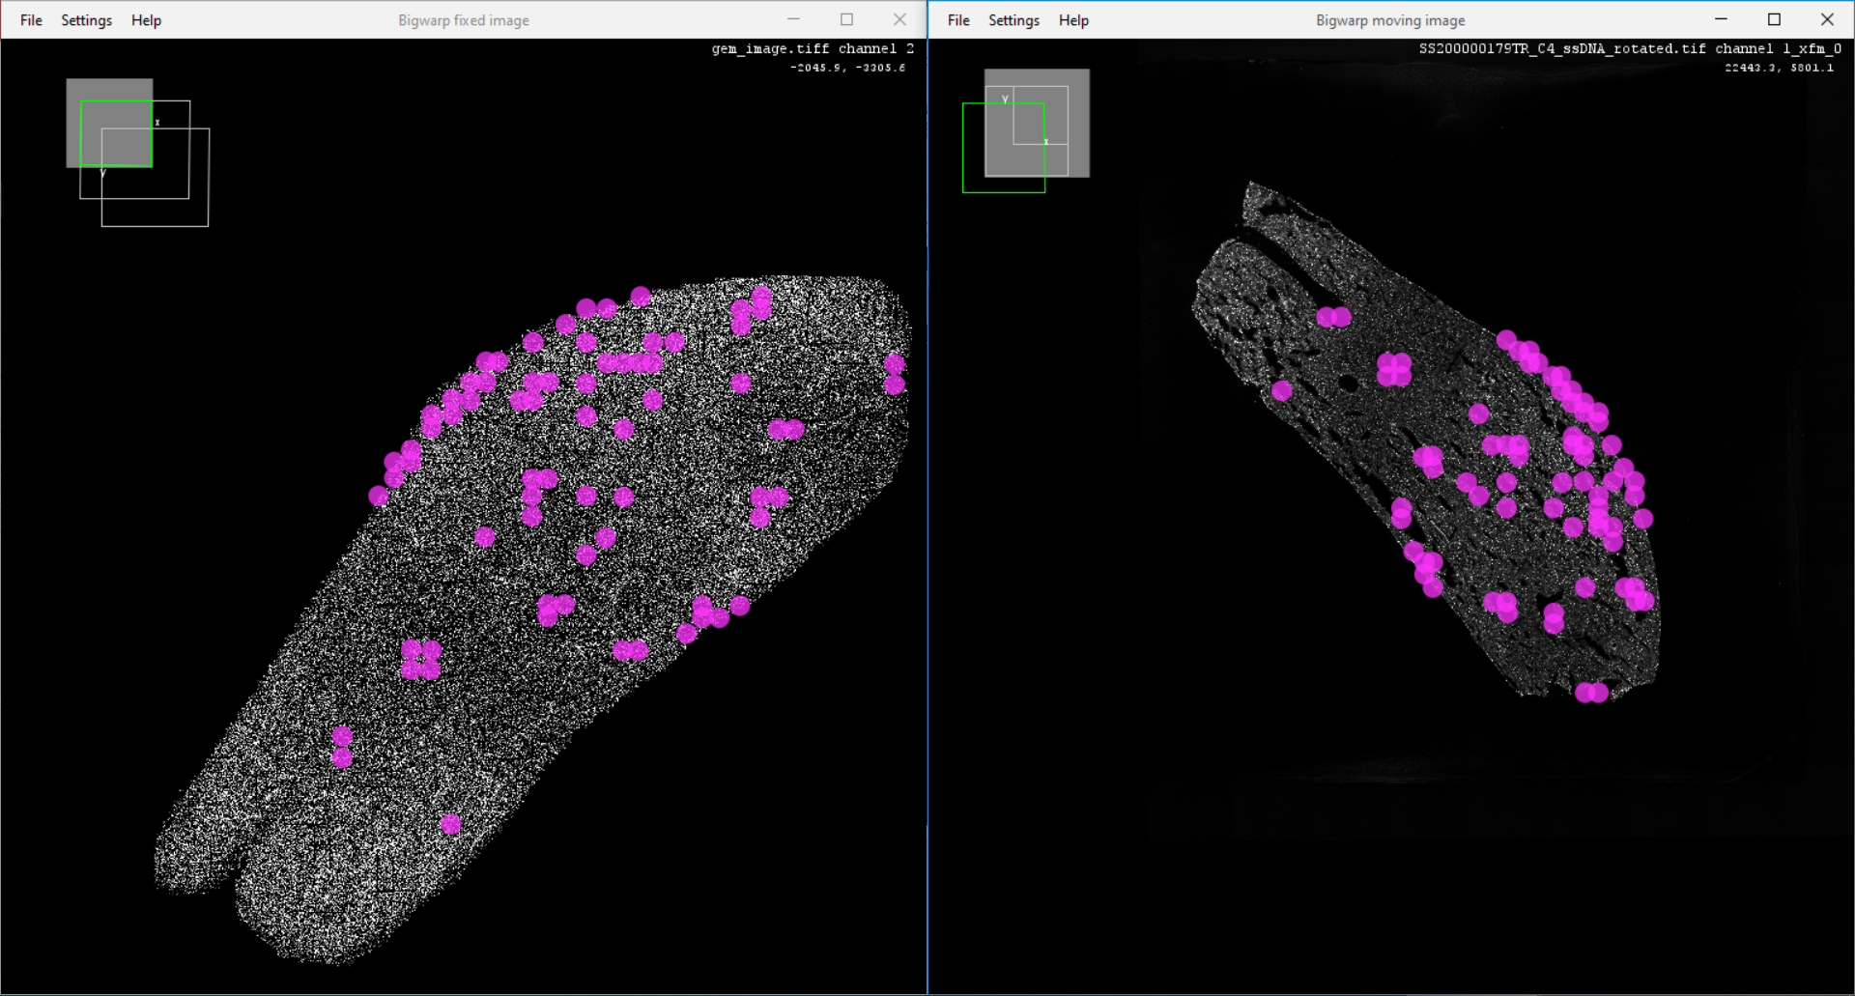
Transcripts image
ssDNA image
Stereo-seq liver sample

Slide 8
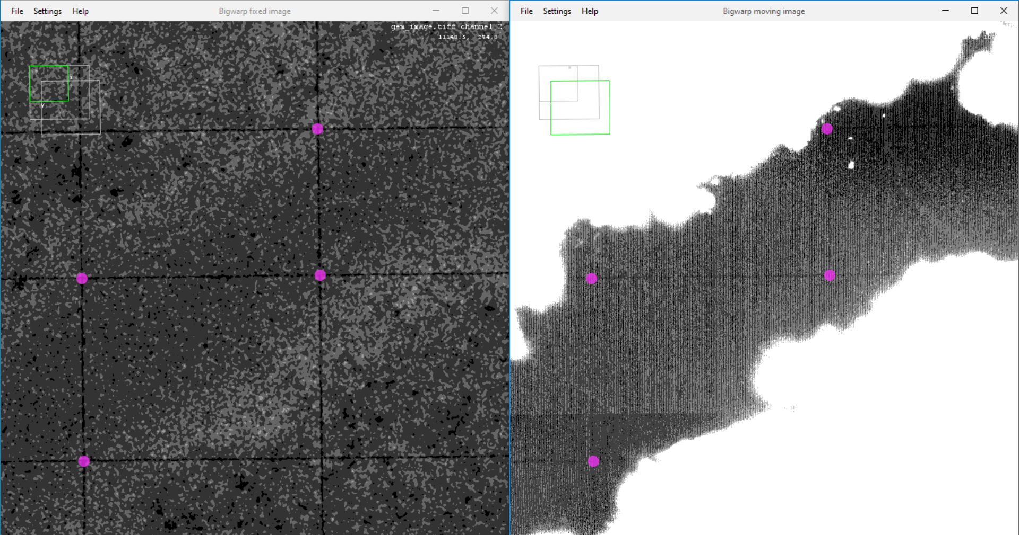
Transcripts image
ssDNA image
Stereo-seq liver sample

Slide 9
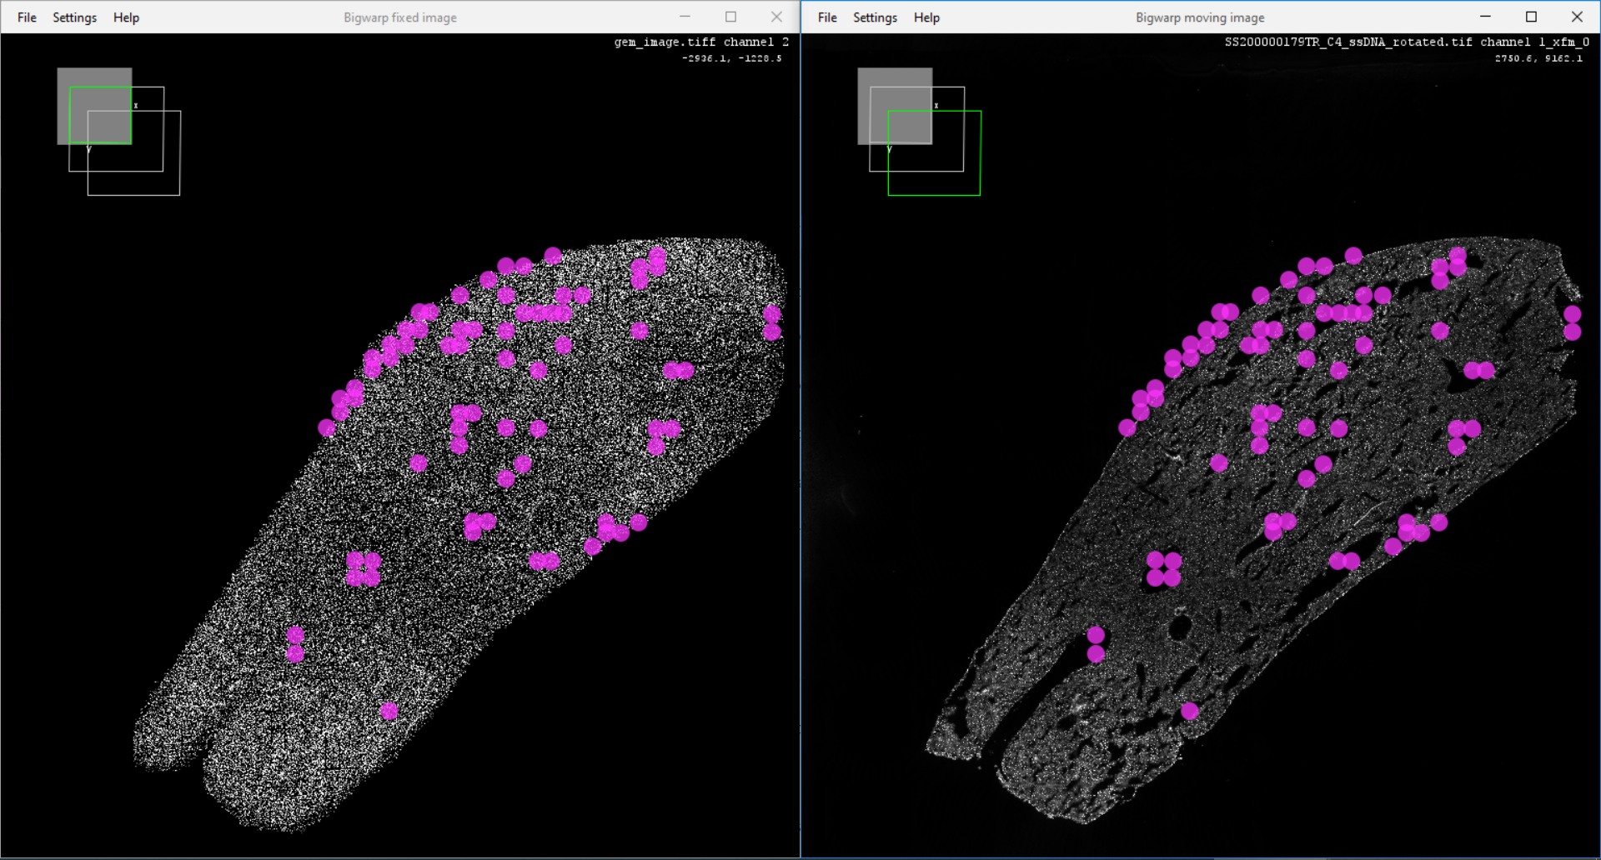
Transcripts image
ssDNA image
Stereo-seq liver sample

Slide 10
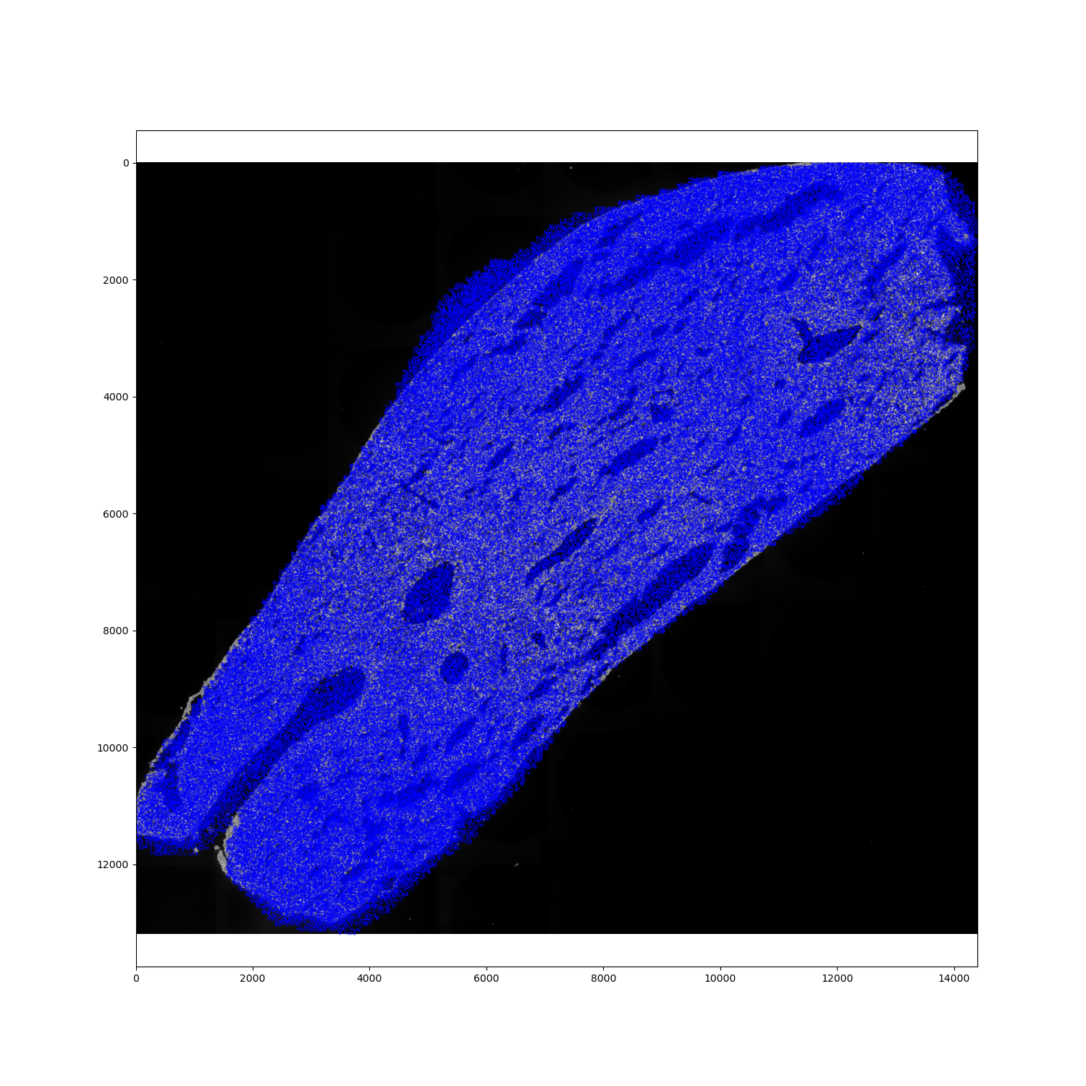
Transcripts (blue) plotted on ssDNA image

Slide 11
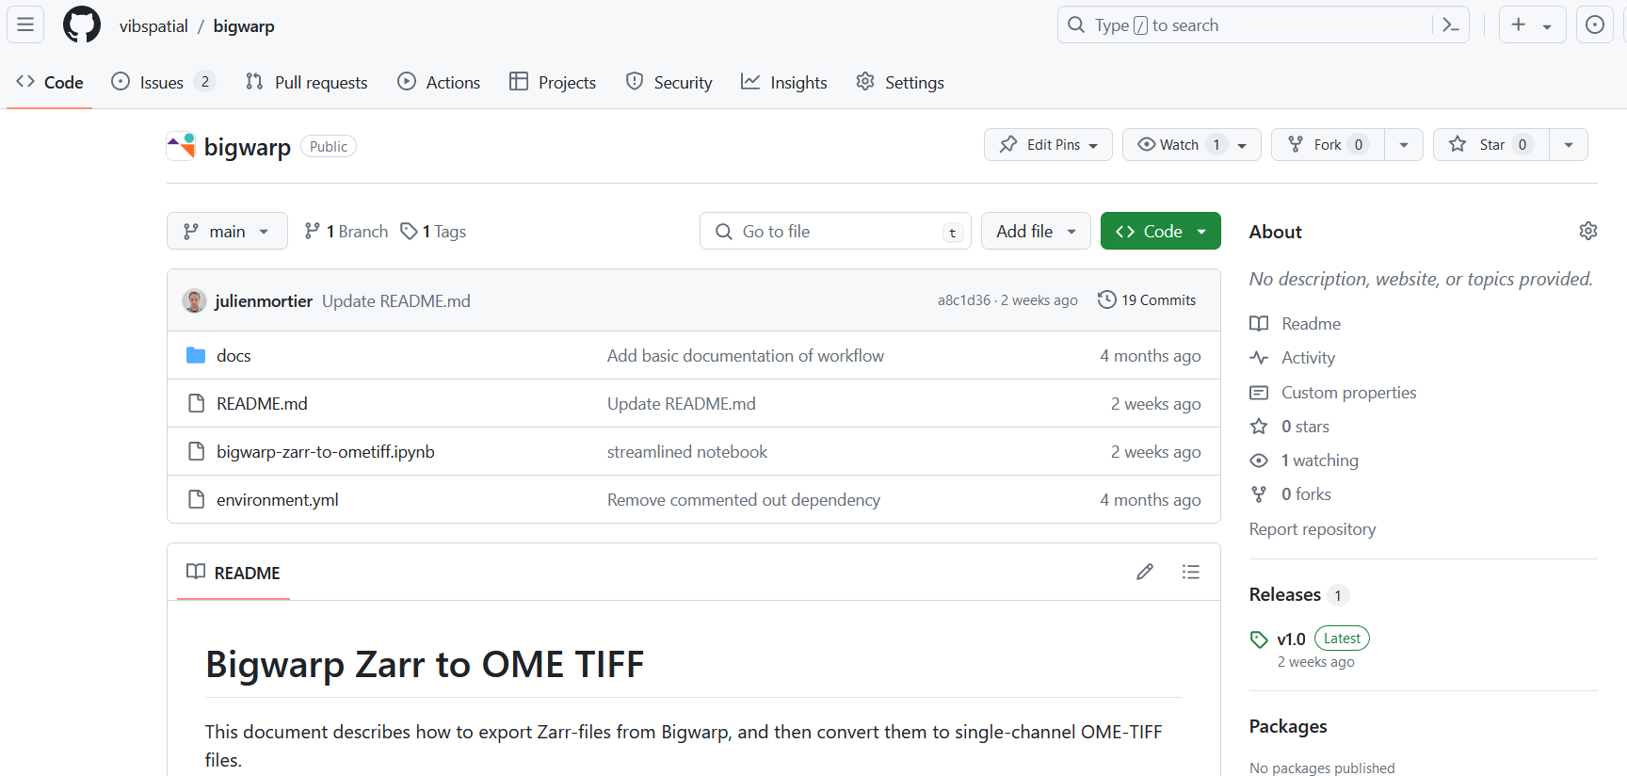
Want to get started with BigWarp?
https://github.com/vibspatial/bigwarp
Contains code and documentation from VIB Spatial Catalyst on how to run Bigwarp, export the output as Zarr and convert it to OME TIFF.

